Slide 1
“Total War”

Slide 2
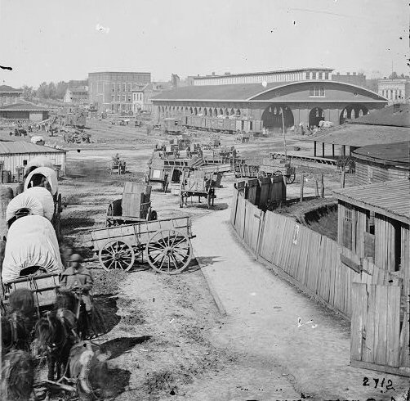
Railroad station at Atlanta, Georgia (before Sherman)

Slide 3
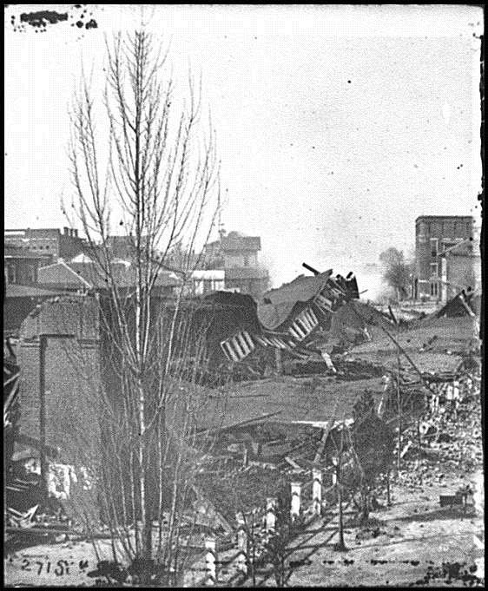
Railroad Station at Atlanta, Georgia (after Sherman)

Slide 4
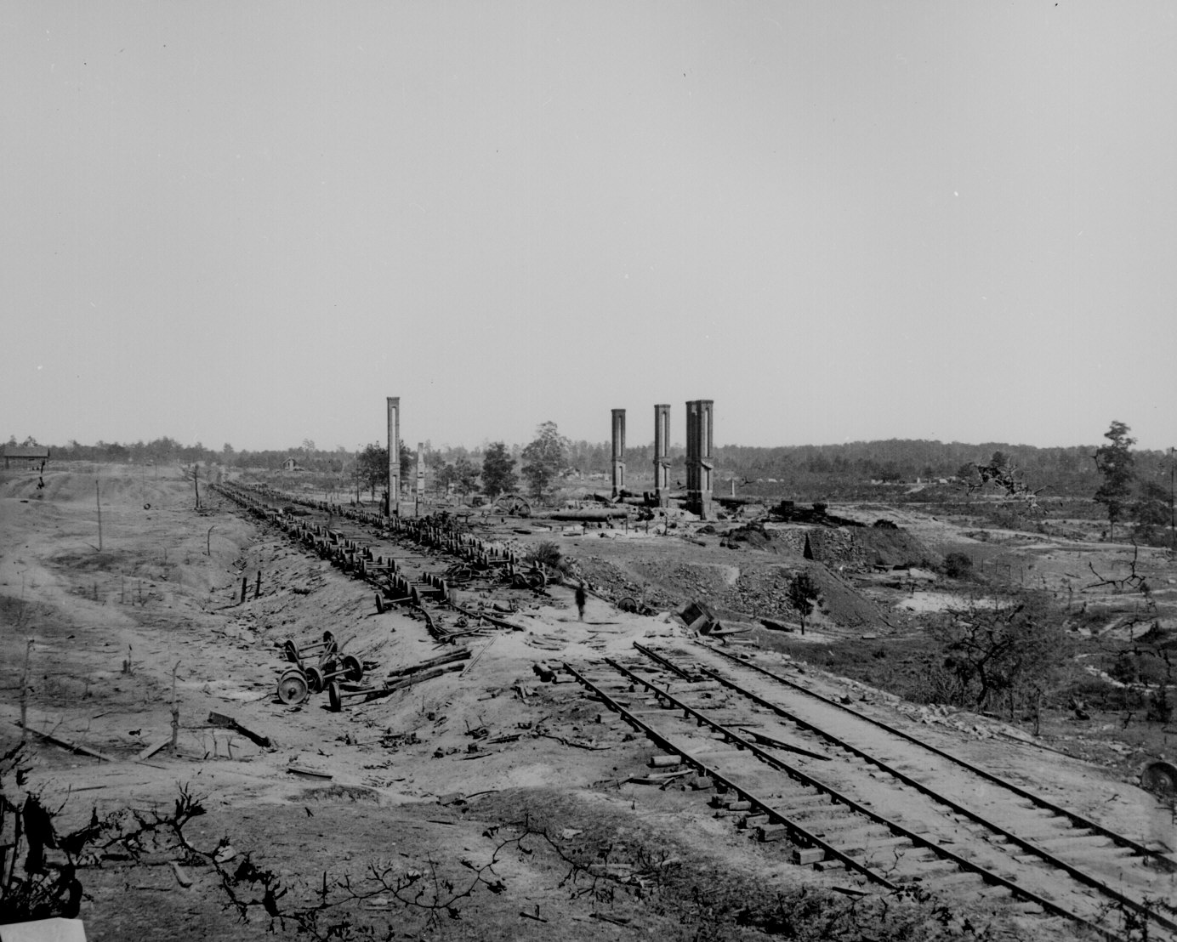
Railroad Station #2 in Atlanta, Georgia

Slide 5
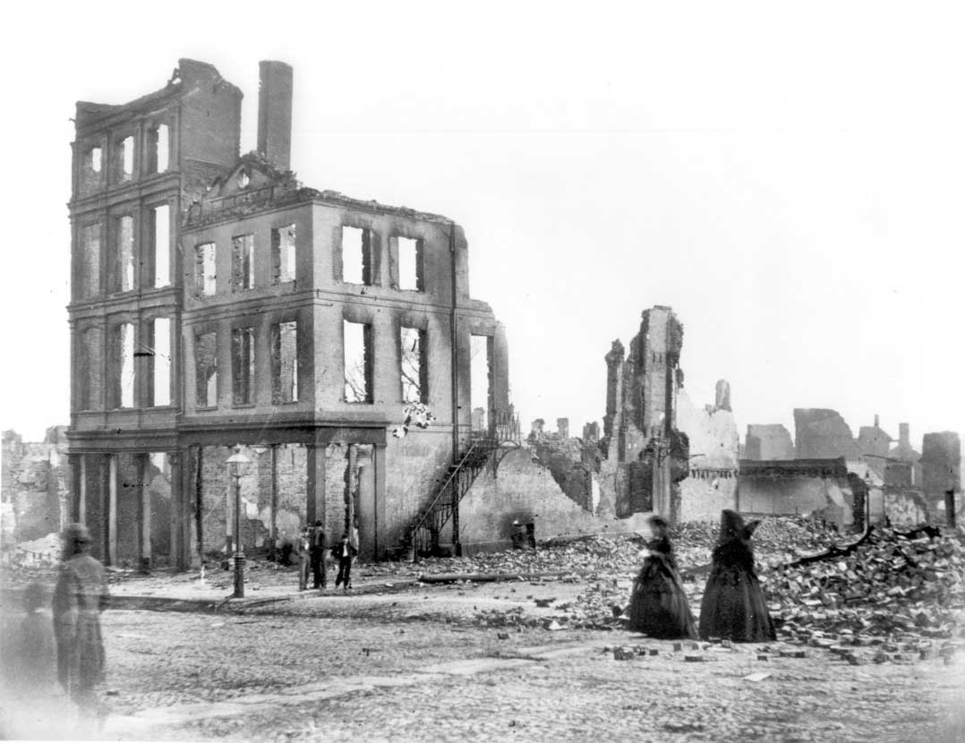
Downtown Charleston, South Carolina

Slide 6
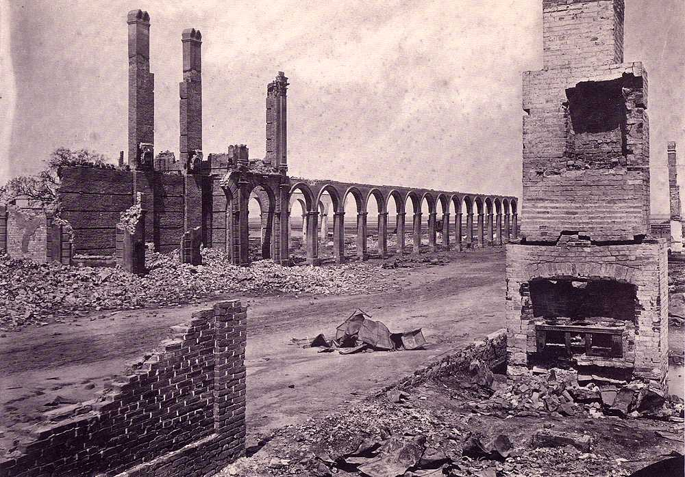
The remains of the railroad station at Charleston, South Carolina

Slide 7
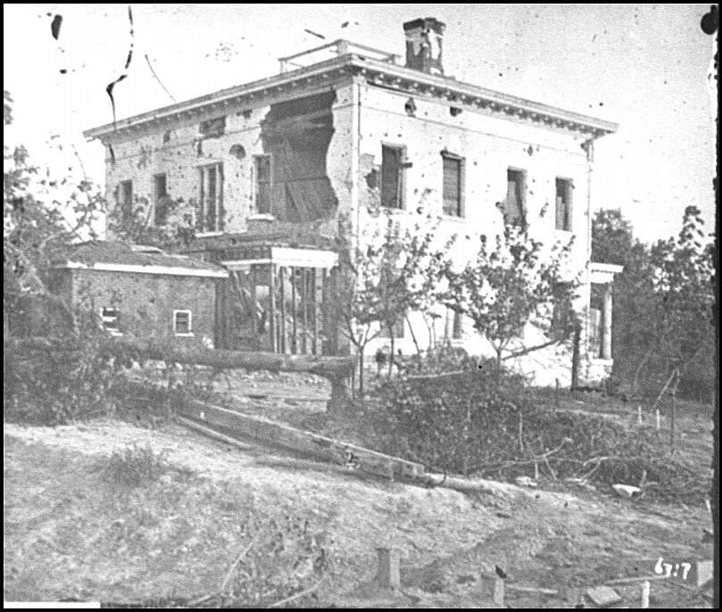
Plantation in Georgia

Slide 8
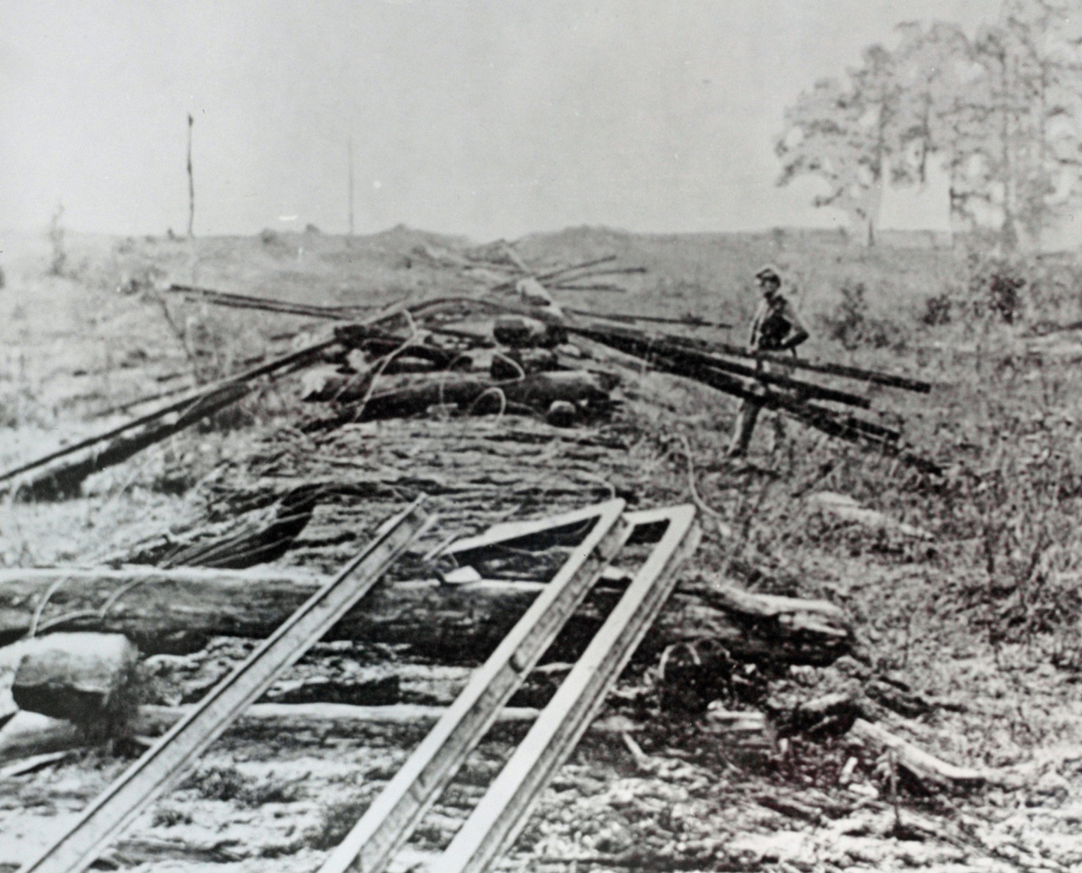
Destruction of railroad tracks (Georgia)

Slide 9
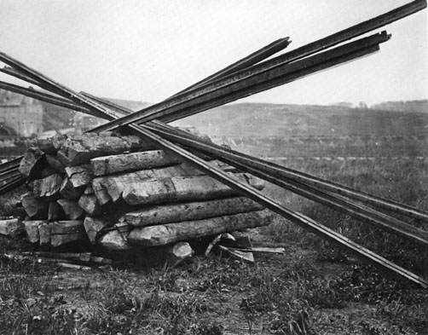
Preparation for making a “Sherman Necktie”

Slide 10
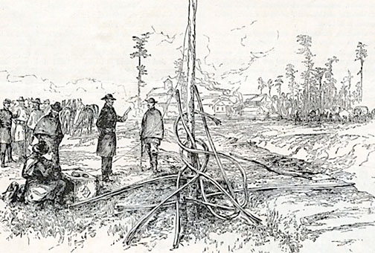
Final product: “Sherman Necktie”

Slide 11
