Slide 1
Quote of the Day:
“I don’t know what’s so great about living in Switzerland, but the flag’s a big plus…”
***Thanks to Arianna Napper for this super cheesy quote

Slide 4
Total War

Slide 5
Union strategy #1: The Anaconda Plan
Brainchild of General Winfield Scott
Defeat the CSA in three steps:
Create a military blockade of all southern ports
Cut the Confederacy in half using the Mississippi River
Take the CSA capital (Richmond, VA)

Slide 7
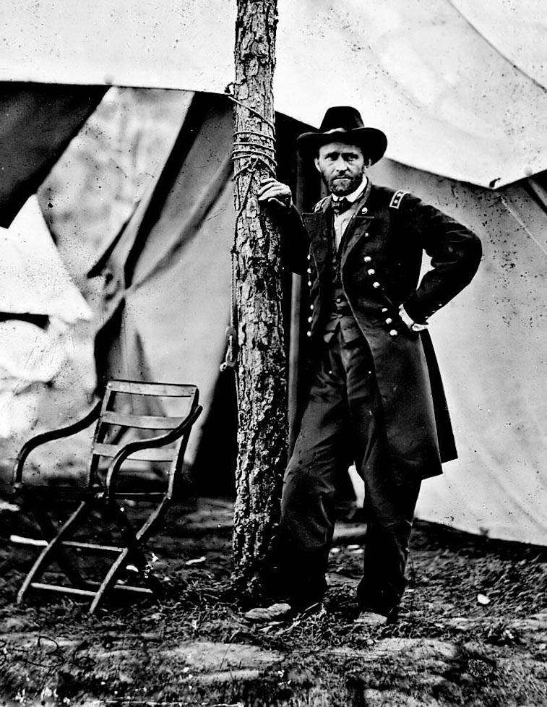
Union strategy #2: “Total War”

Slide 8
Plantation in Georgia

Slide 9
Railroad station at Atlanta, Georgia (before Sherman)

Slide 10
Railroad Station at Atlanta, Georgia (after Sherman)

Slide 12
Downtown Atlanta, Georgia

Slide 13
Downtown Charleston, South Carolina

Slide 14
The remains of the railroad station at Charleston, South Carolina

Slide 15
Secession Hall in Charleston, South Carolina

Slide 16
Destruction of railroad tracks (Georgia)

Slide 17
Preparation for making a “Sherman Necktie”

Slide 18
In process: making a Sherman’s necktie

Slide 19
Final product: “Sherman Necktie”

