Slide 1
“Remember the Alamo!”

Slide 2
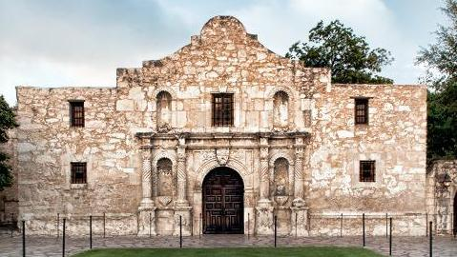
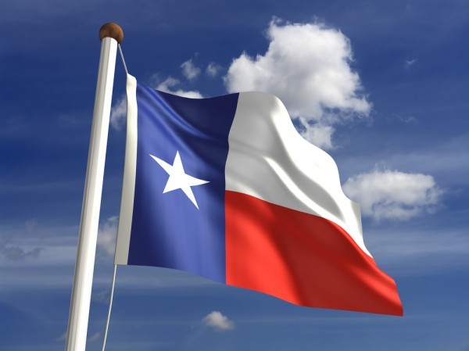
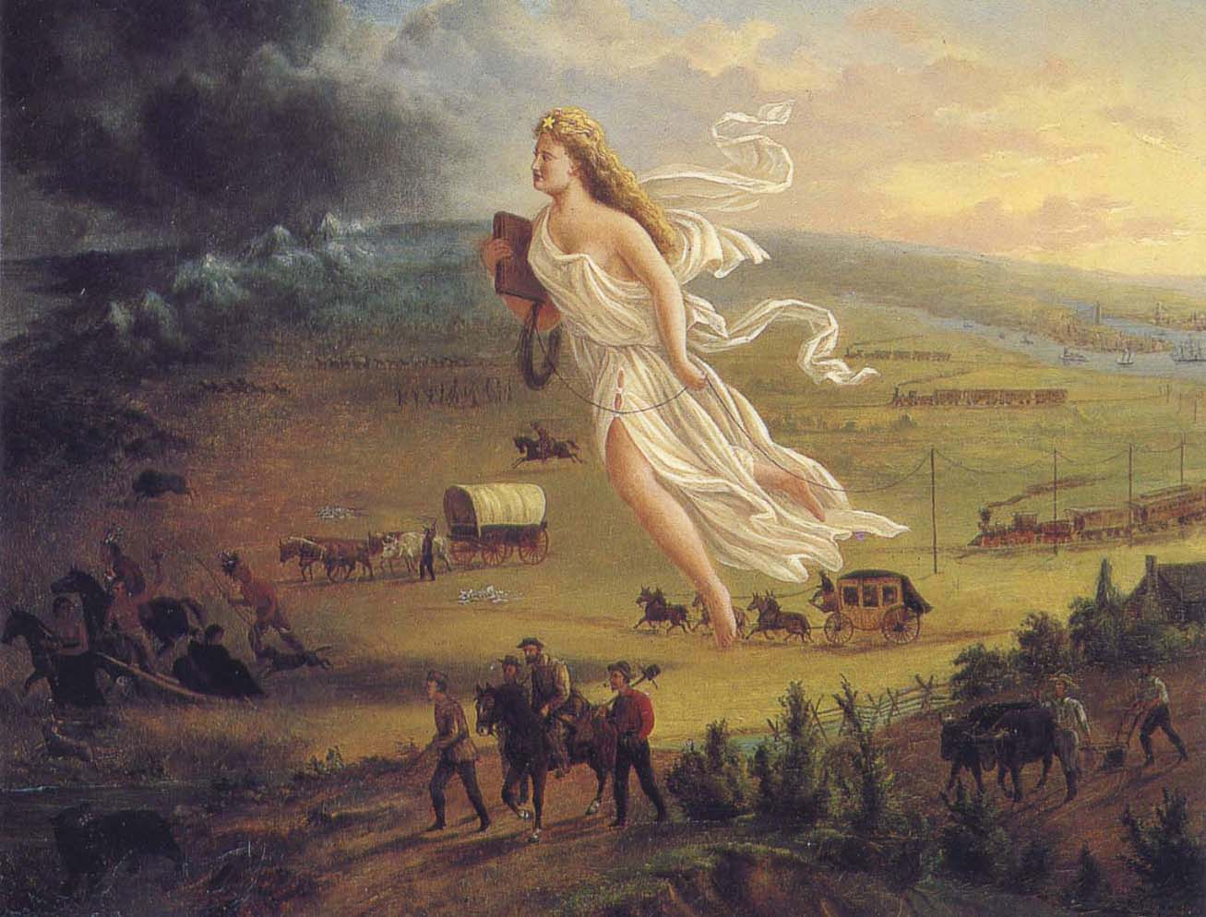
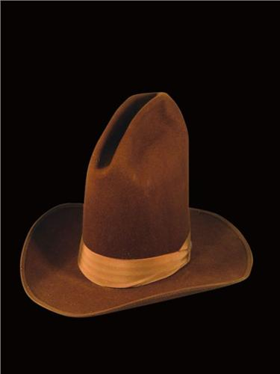
Clues…

Slide 3
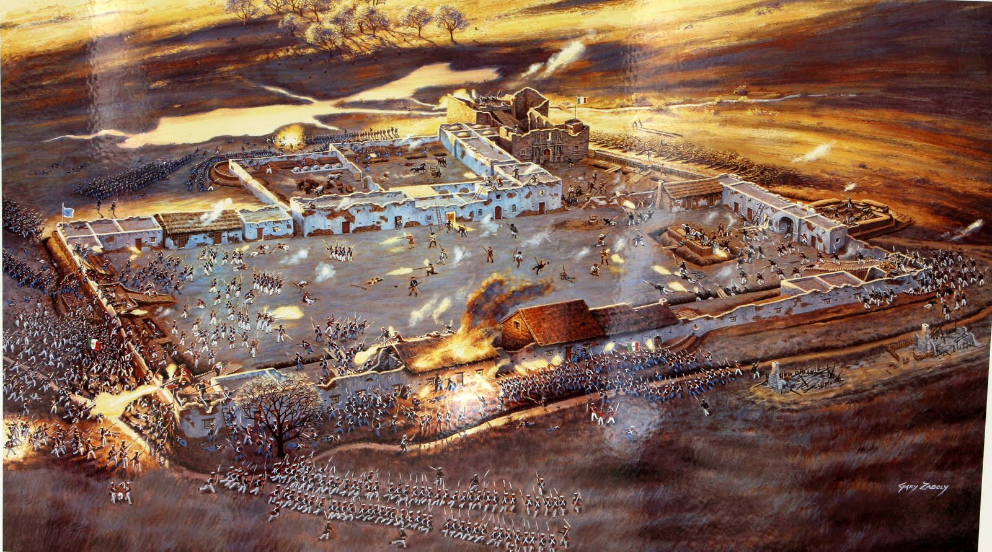

Slide 4
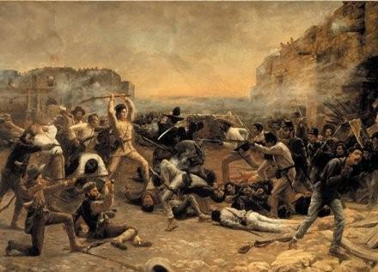

Slide 5
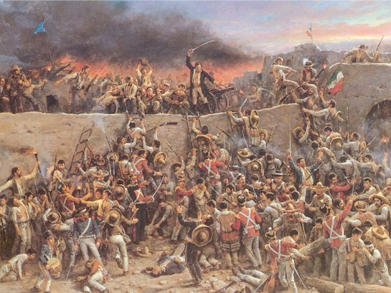

Slide 6
Alamo-related words
"Remember the Alamo!"

Slide 7
Song: “Ballad of the Alamo”
"Ballad of the Alamo" by Marty Robbins

