Slide 1
Quote of the Day:
“#shoutout to my arms for always being on my side…”

Slide 2
The French and Indian War

Slide 3
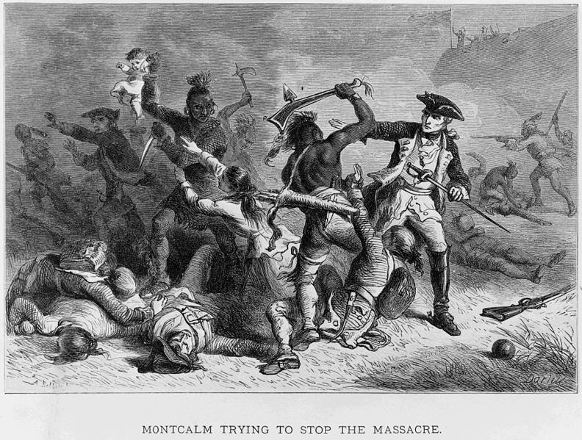

Slide 4
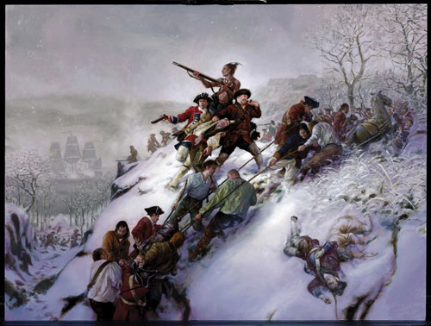

Slide 5
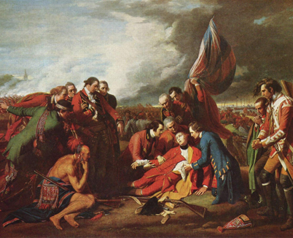

Slide 6
