Slide 1
Slavery in Colonial America

Slide 2
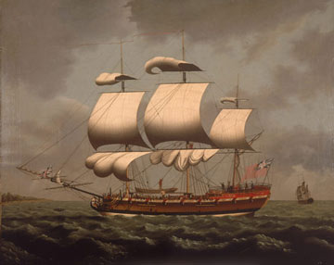

Slide 3
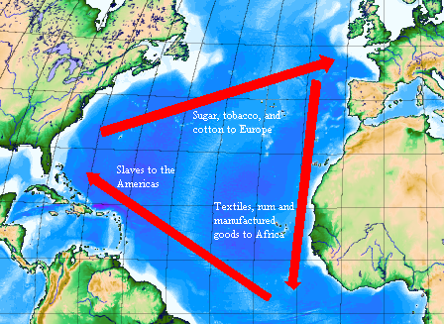
“Triangle Trade” (early)

Slide 4
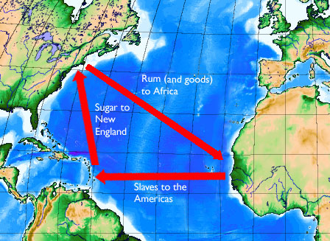
“Triangle Trade” (later)

Slide 5
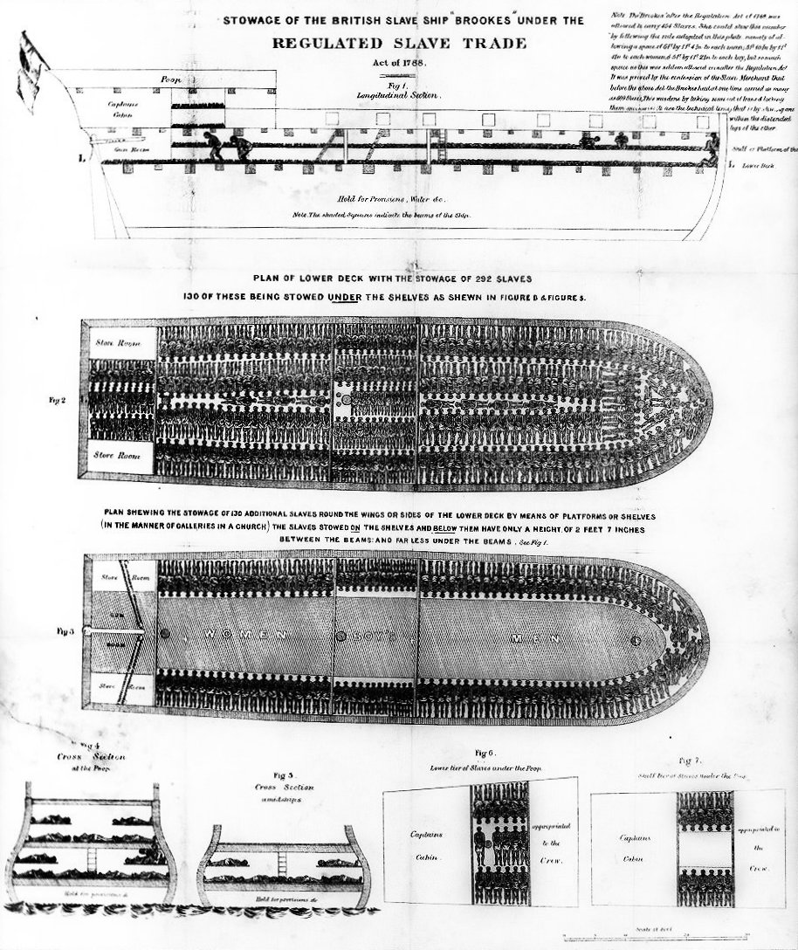

Slide 6
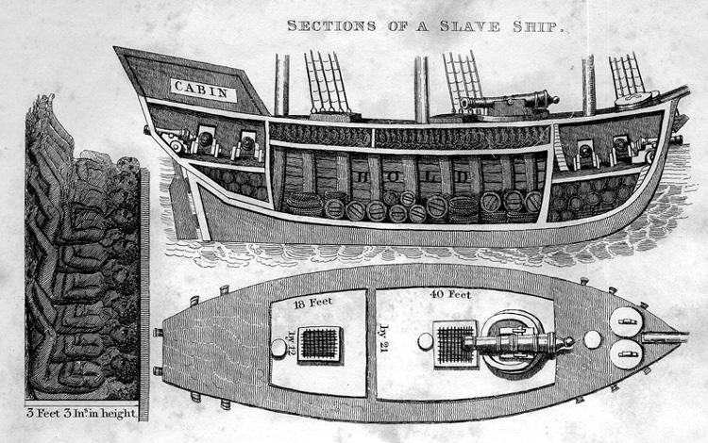

Slide 7
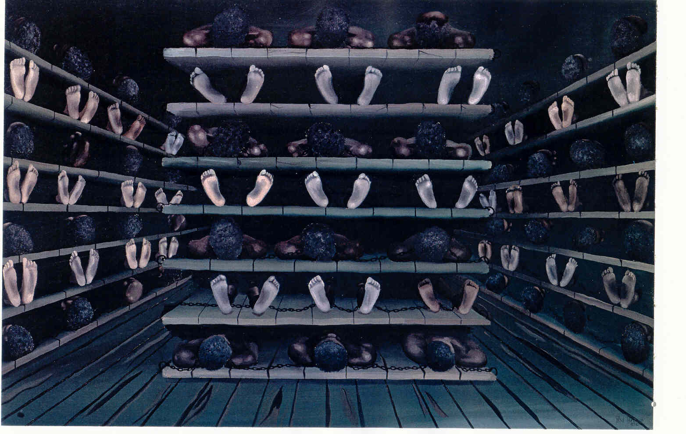

Slide 8
Basic Facts
Over 15 million Africans were brought to the Americas as slaves
It took about 2 months to cross the Atlantic Ocean
Boats budgeted about 7 square feet per person – the more bodies, the more profit
Mortality rates were often 10-15%

Slide 9
Treatment of the “Cargo”
Africans were forced to lay on shelves like books
Each slave was chained to both the shelf and another slave
Bathrooms were not provided
Food was minimal – just enough to keep slaves alive (in the name of saving profits)
Because of the filth, disease was rampant and most slaves who died, died from Smallpox, Dysentery, or Scurvy

Slide 10
Treatment of the “Cargo” (cont.)
The stench below deck was unbearable
Slaves were brought up to the deck and exercised, but many ended up with life-long crippling due to being in chains for such an extended time
Discipline was extremely harsh – the idea was to prevent misbehavior by making an example to the other slaves – flogging, cutting off of limbs, and general brutality were common

Slide 11
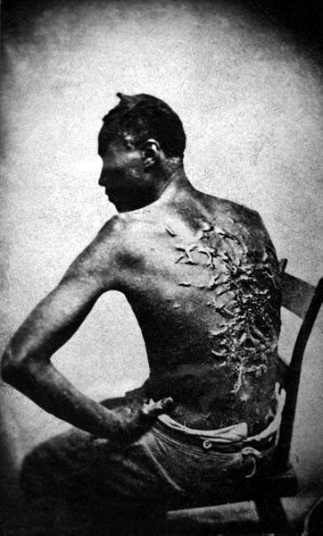

Slide 12
Ultimately, it was all about the money…
The men, women, and children “lucky” enough to survive the trip were sold to slave brokers.
They were cleaned up, fattened for a month or two, and taken to public auctions to be sold to the highest bidder.

Slide 13
The Value of a human being
Slaves purchased in Africa for about $25 in cash or trade goods (i.e. rum)
Slaves sold to slave brokers in the Americas for about $120 each
Even with 15% mortality rate, boats carrying 400 slaves could expect to make over $42,000 on a single voyage (in today’s dollars, that would be about $1,302,000)
Slaves were sold by the slave brokers for around $300 each

Slide 14
