Slide 1
How We Got Oregon

Slide 2
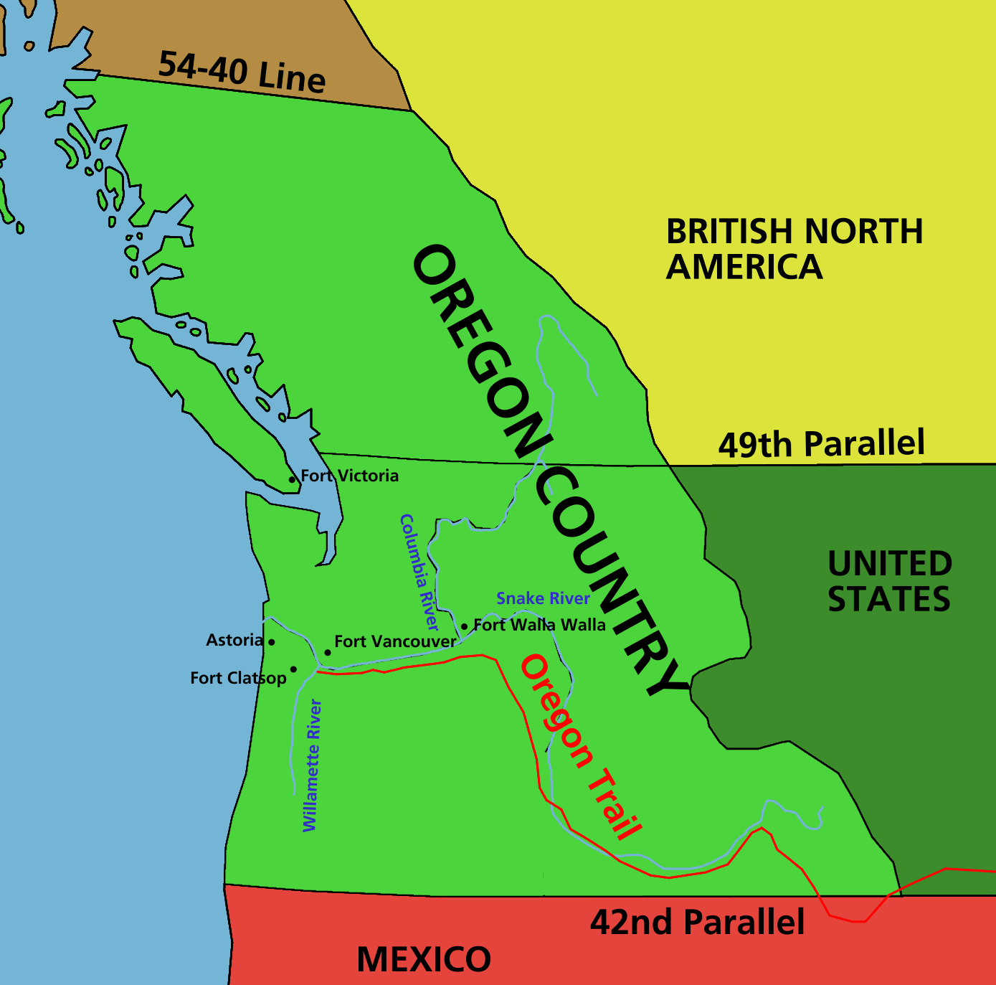
How we got Oregon…
First there were four: Spain, Russia, Great Britain, and America

Slide 3
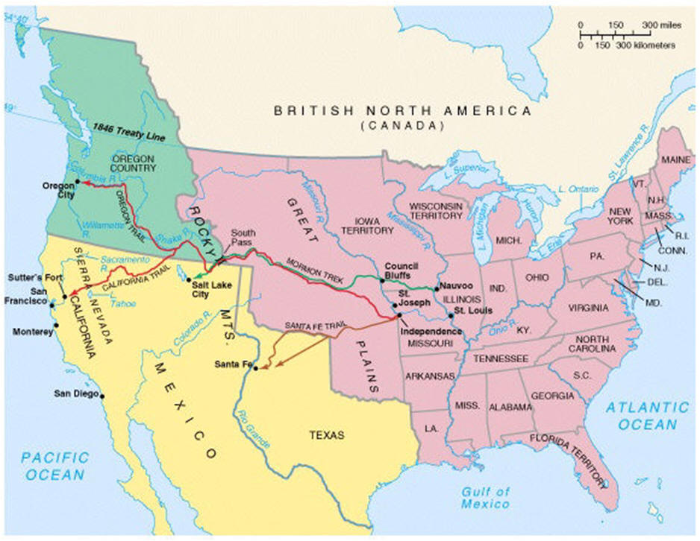

Slide 4
Then, there were three…
In the Spanish Cession (1819), Spain gives up Florida to America. In addition, it gives up its claim to the Oregon Country.
America Spain
Gets Florida Gets $5 million
Gives up Texas Gives up Oregon
Gives up Florida

Slide 5
Then there were two…
Through the Russo-American Treaty, Russia gave up its claim to the Oregon Country in 1825. They did so because:
They couldn’t defend their claim (no military there)
They couldn’t govern the territory from so far away
The Alaskan territory had far more value to them

Slide 6
Then, there’s politics…
In the presidential election of 1844, James Polk used Oregon-related campaign promises to gain votes
“All of Oregon or none!”
“Fifty-four forty or fight”
Once he won, though, he conveniently changed his mind about fighting a war with Great Britain
America agreed to a compromise treaty with Great Britain and split the land in two at the 49th parallel

Slide 7
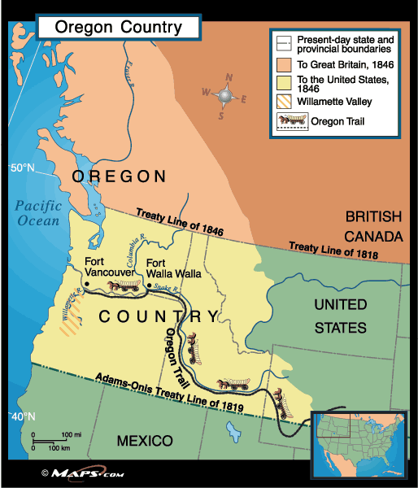
The final Map

