Slide 1
Education Reform in the 1800’s

Slide 2
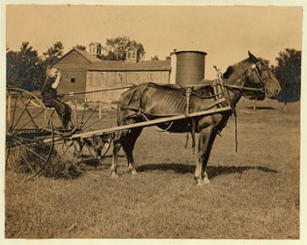
This is what most kids were doing rather than going to school. Poor families couldn’t afford to let their children leave their farms because they were needed to do daily work. These families worked hard just to survive (notice that even the horse isn’t well-fed).

Slide 3
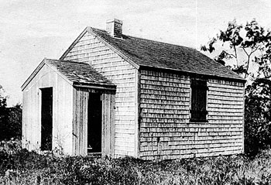
This is a typical “one-room schoolhouse”. These early schools had a single teacher responsible for teaching all students (usually from kindergarten through 8th grade). No bathrooms, no air conditioning, no furnace (wood stove, if lucky…) – just a basic, small building.

Slide 4
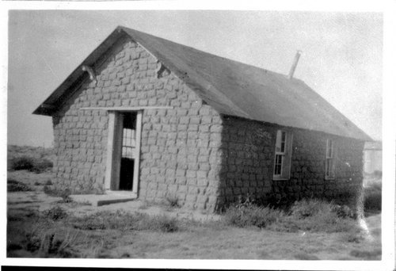
School buildings were made out of whatever materials were available, depending on what part of the country you lived in. This one, in the Great Plains, was made out of mud bricks.

Slide 5
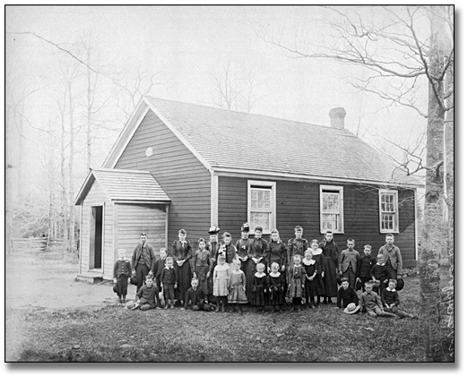
Over the next few slides, notice two things: (1) how many students and (2) the wide range of age of the students. Imagine how challenging it must’ve been for a single teacher to teach all subjects to all of these different-aged students at the same time.

Slide 6
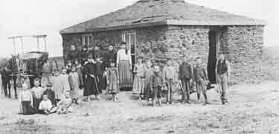

Slide 7
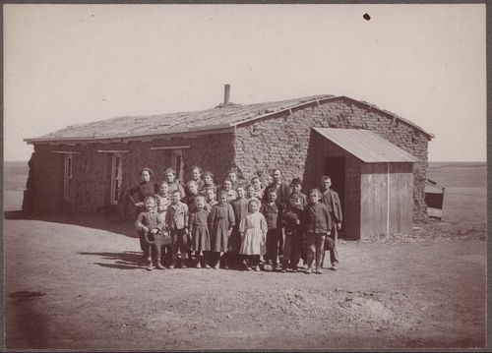

Slide 8
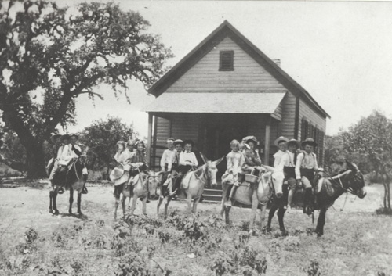
No school buses here. The vast majority of students walked to school (often from farms that were multiple miles away). Lucky students were able to ride a donkey or horse.

Slide 9
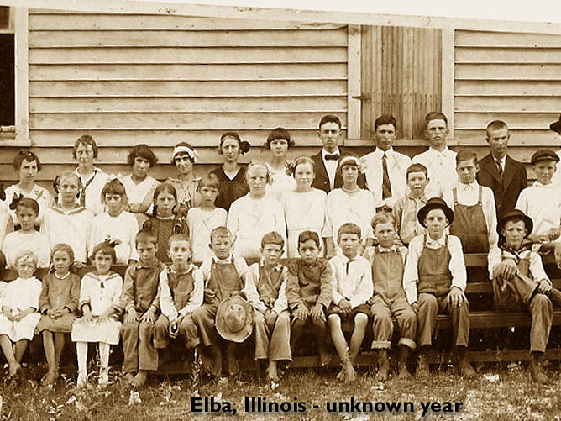
Overcrowding was always an issue. One school would typically serve a students from a very large area.

Slide 10
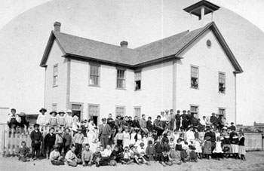

Slide 11
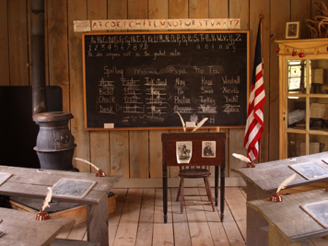
Schools were always short of supplies. Notice the individual chalkboards that were often used in place of paper. Only the basics. Imagine how amazed students back then would be with Chromebooks…

Slide 12
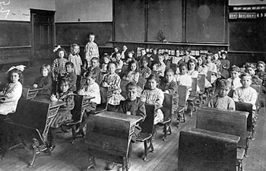

Slide 13
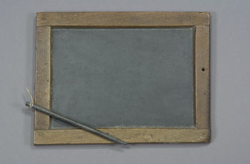

Slide 14
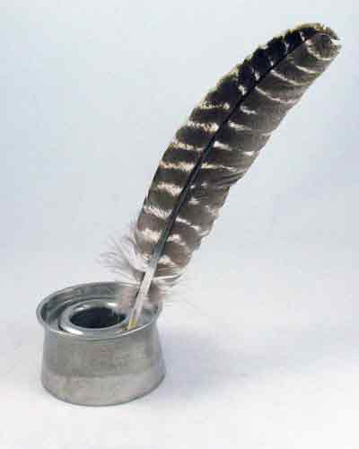

Slide 15
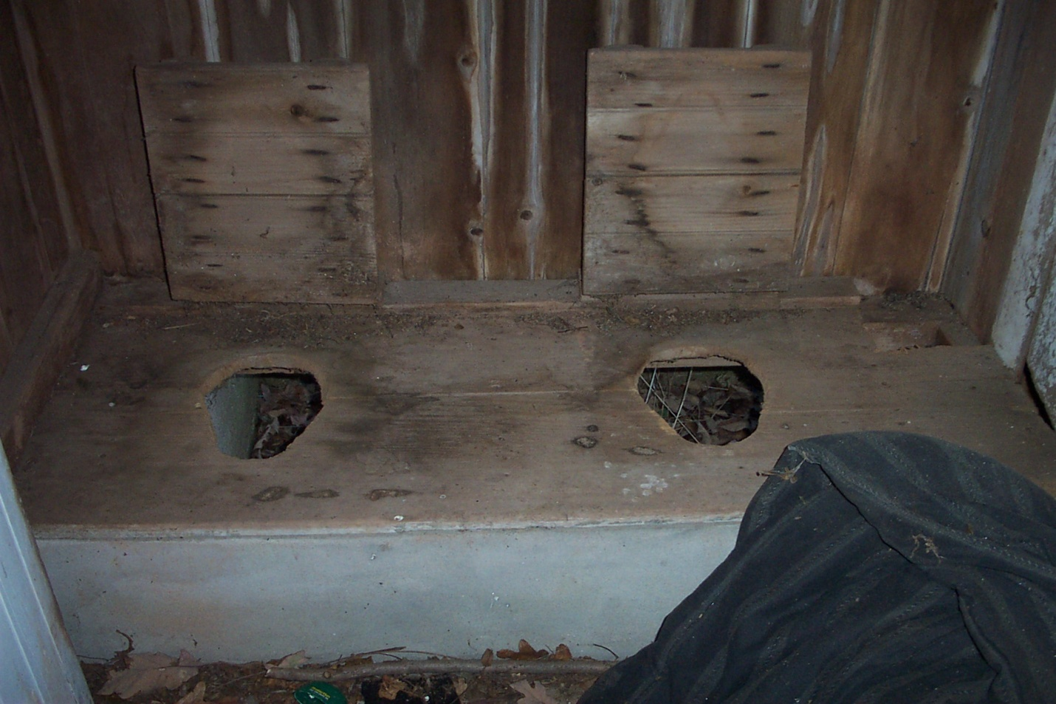
Bathroom pass, anyone? I bet this was super comfortable in the middle of winter! By the way, there was no toilet paper. Most schools kept a Sears Roebuck catalog in the outhouse – pages were ripped out as needed.

Slide 16
Public School Reforms
Most Responsible for changes:
Horace Mann
Improvements suggested and implemented:
Use taxes to pay for better schools
Pay teachers higher salaries
Better, specialized training for teachers

