Slide 1
Welcome to Bradnerville!!!
*established 1998

Slide 2
Quote of the Day:
“School-related puns are in a class by themselves…”

Slide 3
Meet the King of Bradnerville…
(The guy, not the fish…)

Slide 4
About me:
22nd year teaching
Married 5 years ago
My daughter, Maddie, is a sophomore at Cleary University
I have two dogs – Barney, and Sprinkles (yes, Sprinkles…)
What do I do when I’m not teaching?
Fishing
Biking
Hiking
Hoarding (just look around you – I obviously have a problem…)

Slide 5
My Happy Place…
Manistee, Michigan

Slide 6
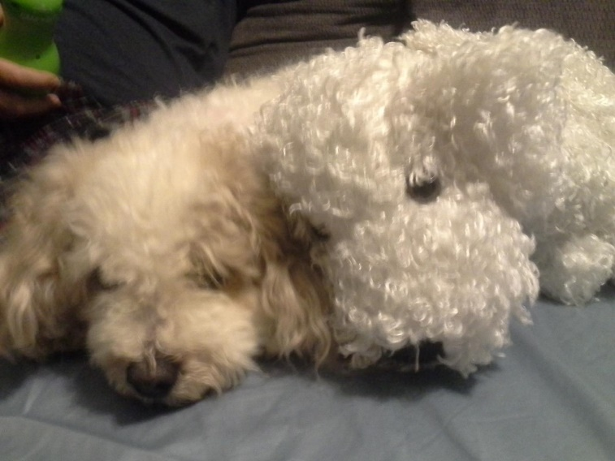

Slide 7
My Education:
University of Michigan (bachelors degree in Anthropology)
Eastern Michigan University (bachelors degree in English and History)
Marygrove College (master’s degree in The Art of Teaching)

Slide 8
Why I became a teacher:
Grandpa Bradner was the founding president of Schoolcraft College
Dad taught for over 40 years
I walked into 8th grade SS, and I met Ms. Boltz…

Slide 9
My Classroom Webpage:
www.historyaccordingtobradner.com
***All assignments, handouts, and necessary materials (textbook pages, etc.) can be found there
***Updated daily

Slide 10
What do you do if you miss a day of school?
You have 2 choices:
When you return, go to the “What Did I Miss?” board in the classroom
Visit my website: www.historyaccordingtobradner.com
***Please bookmark this site in your cellphone

Slide 11
My Tardy Policy:
When the bell rings, you need to be in your seat. If you’re not, you’re late. Phone call home after 3, tardy referral on your 4th.

Slide 12
At the end of the hour:
The bell does not dismiss you, the King does!!!
If you want to leave on time, everyone needs to be in their assigned seats!

Slide 13
History Notebooks and/or pocket folder:
You need either a single-subject notebook or a pocket folder for this class
Notebooks/folders will be purged after each unit
You must have yours no later than next Tuesday (9/3)

Slide 14
Demonstrating What You’ve Learned In This Class
Group/partner work
Reporting out to the class
Rubric (below)
 | Complete | Accurate | Connected to Big Question | Creative
3 pts | Covered all important info | All info is accurate | Made clear connection to Big Question | Selected and completed a level 3 task at an 8th grade level
2 pt | Covered some important info | Some info is accurate | Connection was made but unclear | Selected and completed a level 2 task at an 8th grade level
1 pt | Covered very little important info | Very little info is accurate | n/a | Selected and completed a level 1 task at an 8th grade level
0 pts | Covered no important info | No info is accurate | No connection was made | No task was completed

Slide 15
Homework:
From now on, we’ll call it “homefun” instead
If you take advantage of the time provided in class, you won’t have much of it. If you don’t, you will (and I’ll be contacting home to talk to mom/dad about it)
Any assignment can be turned in late (‘til the last day of the quarter), but only for minimal credit
Homefun isn’t busywork – it has a purpose. Please do yours every time it’s assigned!
If zeros become a habit for you, I’ll be communicating with home

Slide 16
Snacks:
You can bring snacks to class
You can bring water to class
These are privileges -- if either becomes a distraction, or if litter becomes a problem in Bradnerville, these privileges will be lost
***Common sense: if you make a mess with your food, please clean it up the best you can

Slide 17
Cell Phones:
We all love ‘em, but they must be off and away in this class
I won’t be on mine either
If there is some emergency at home, your parent will contact the office, and they will find you and relay the message

Slide 18
Lost-and-Found
Located on the file cabinets next to the old radio
If not claimed within a week, I’ll move things to the school lost-and-found downstairs

Slide 19
Passes…
You get three (3) per quarter
You need your pass sheet
If you need to use the bathroom in an emergency, and you don’t have your planner, you’ll need to use the bathroom in the main office (my office pass will cost you 2 minutes after class)
***New pass sheets will be handed out on the first day of 3rd quarter

Slide 20
“Quality Work”
This is your job (p.s. You’ll get out of school what you put into it)
Part of my job is to prepare you for high school, so I won’t accept garbage or sub-eighth-grade-quality work from you
“Quality Work”…
is complete
is neat and easy to read
identifies the author
identifies the assignment (has a title)
reflects 100% effort

Slide 21
Expectations:
Bring all needed materials to class
Remain in seat during instructional time
Keep hands, feet, and other objects to yourself
Be respectful (to self, others, and property)
Follow directions the first time they are given

Slide 22
What are your expectations of me?

Slide 23
M&M Activity
Take 5 M&M’s
***DO NOT EAT THEM UNTIL King.B SAYS YOU CAN***
2. Pick 3 M&M’s, and share by color:
Green favorite movie/book
Red favorite sport
Yellow A hobby of mine is…
Blue favorite music group/performer
Brown Something I do well…
Orange If I won a million dollars, I’d…

